Slide 1
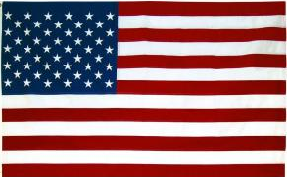
U.S. Military Terrorists
 | Mental Health | Married | Divorced | Aligned with: Domestic | Aligned with: International | US: Birth | US: Naturalized
Military | 48% | 35% | 13% | 18% | 75% | 90% | 8%
Non-Military | 11% | 18% | 3% | 9% | 81% | 63% | 32%
The years of service ranged from 1942 – 2017.
45% of the crimes occurred between 0 and 5 years from exiting the service.
88% served as enlisted members.
30% of these individuals received an honorable discharge at the time they left the military, despite a future violent outcome.
75% of these individuals converted to Islam.
MILITARY TERRORISTS USE OF VIOLENCE
All TERRORISTS USE OF VIOLENCE
Military Terrorists (N=40) 8% of American Terrorists 2001-2018
© 2021 Terry Oroszi

Slide 2
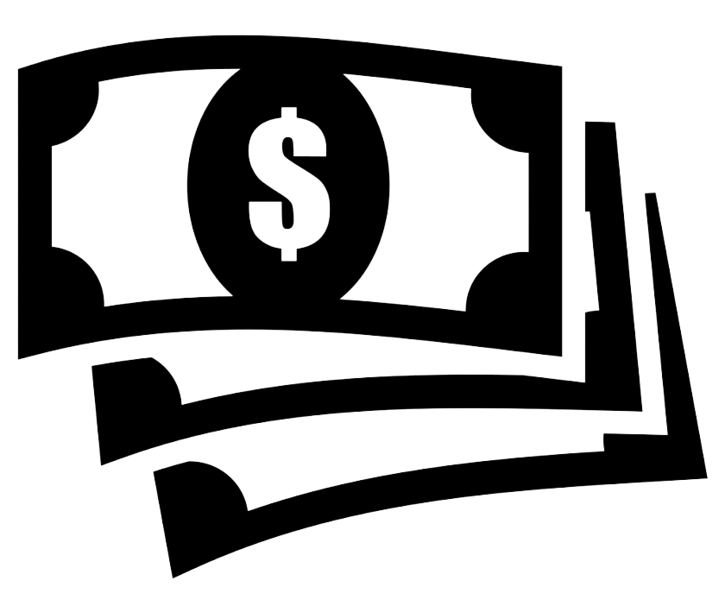
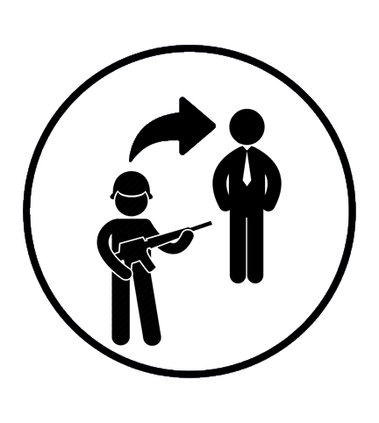
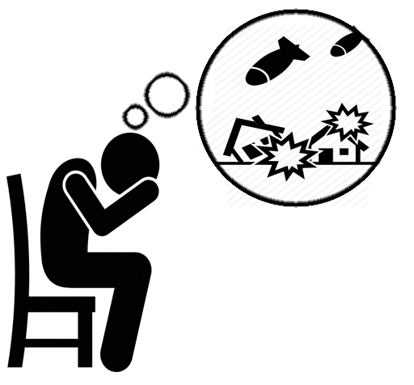
U.S. Military Terrorists
Why ?
Sign on bonus for military-only
jobs, so they are unprepared for civilian life.
 | Military | Non-Military
Mental Health | 48% | 11%
Married | 35% | 18%
Divorced | 13% | 3%
Military take care of their people
with a home, job, food, so they can succeed without money management skills.
Transition from military to civilian
life is difficult. The sense of brotherhood, comradery, and community is gone.
Jobs that did not
translate to civilian
careers:
combat engineer
infantry
patriot missile
rifleman
signalman
supply specialist
tank crew member
War experience can leave them with PTSD or other mental illnesses. They may be checked more frequently than civilians.
Marriage Incentives. Extra pay means they may marry with less commitment.
Our Study
American citizens with military experience charged and/or convicted of acts related to terrorism. n=40
FBI Report
Active shooters with military service n=13
© 2021 Terry Oroszi

Slide 3
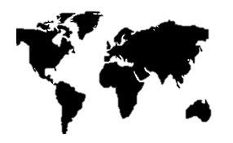
The Profile of an American Violent Extremist
Female: 8%
1
Male: 92%
Ages: 14-20
16%
M
Avg. Ages
2
Ages: 21-39
64%
F
Ages: 40-59
17%
20
50
20
53
Ages: > 60
3%
80%
80%
3
61% College
Not
STEM
64%
STEM
Science Technology Engineering Math
4
78%
18%
3.5%
0.3%
SINGLE
Married
Divorced
Widowed
5
Working Class 48%
Middle Class 11%
Student
19%
No
active
father
6
Upper Class /Professional 15%
Unemployed
7%
7
8
Isolated, Angry or Victimized
Live in non-birth location.
Terry Oroszi, “The American Terrorist: Everything You Need to Know to be a Subject Matter Expert”
© 2021 Terry Oroszi

Slide 4
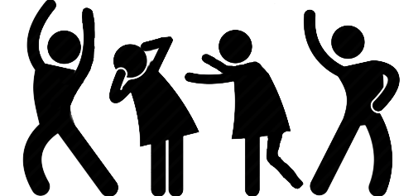
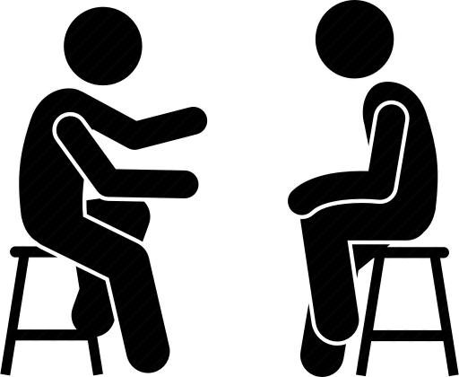
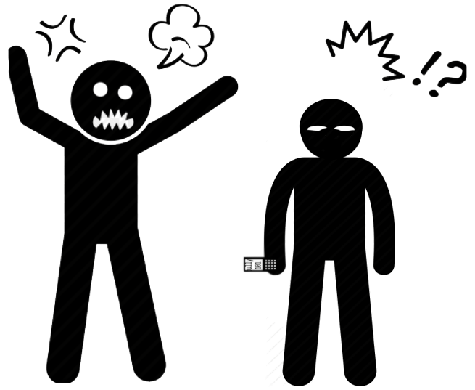
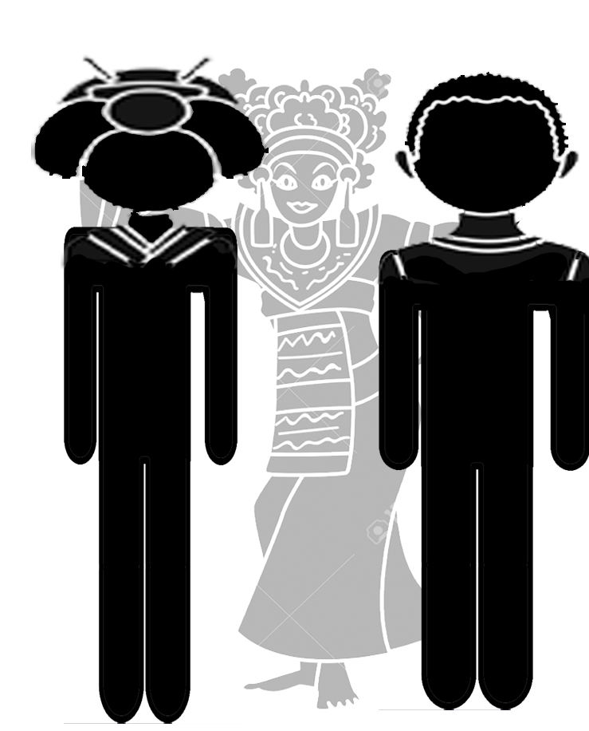
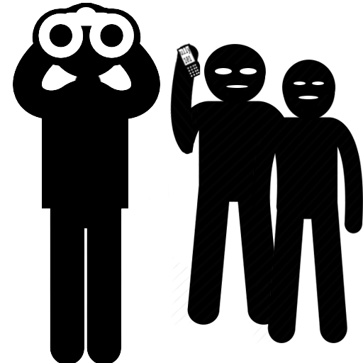
Countering American Violent Extremists
Encourage them to join productive groups.
Help them improve their resume to find gainful employment.
Be a friend and mentor. Change their narrative to something positive.
Be that father (or big brother/sister) figure.
Do not be afraid to call out/address bad behavior.
Talk to them about their country, social norms, and tell them about yours.
If you SEE something, SAY something.
© 2021 Terry Oroszi

Slide 5
© 2019 Terry Oroszi
Numeric Hate Symbology
1-11
Aryan Nations (AK)
23/16
White Power (WP)
100%
100% White
23
White
109/110
“Number of countries Jews have been expelled from” US #110
28
Blood & Honor (LH)
12
Aryan Brotherhood
311
Ku Klux Klan 3 for # of
K’s, and K = 11th letter
13
Aryan Circle (AC)
318
Combat 18 and
Adolf Hitler
13/52
Af. Am. Population 13%, but commit 52% of all murders
33/6
KKK = #3 K’s and 6th era of the Klan
13/90
African American Population = 13%
but commit 90% of all crimes
38
38 stands for CH or "Crossed Hammers” Hammerskin logo
14
Shorthand for 14 Words
43
Supreme White Alliance (SWA) = 19+3+1
14/23
"23 Precepts," Southern Brotherhood
5 Words
Said to police "I have nothing to say"
14/88
Heil Hitler (HH – 88)
511
European Kindred (EK)
14 Words
"We must secure the existence of our people and a future for white children"
737
Public Enemy Number 1/ Pen Death Squad, 737 - letters P, D, and S on a telephone keypad
18
Adolf Hitler (AH)
83
"Heil Christ" or
"Hail Christ” (HC)
21-2-12
Unity, Brotherhood,
Loyalty (UBL)
8-8/88
88 = HH = Heil Hitler
211 Crew
Brotherhood of Aryan Alliance (BAA)
9%
% of world population
that is white

Slide 6
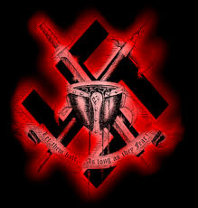
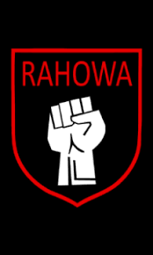
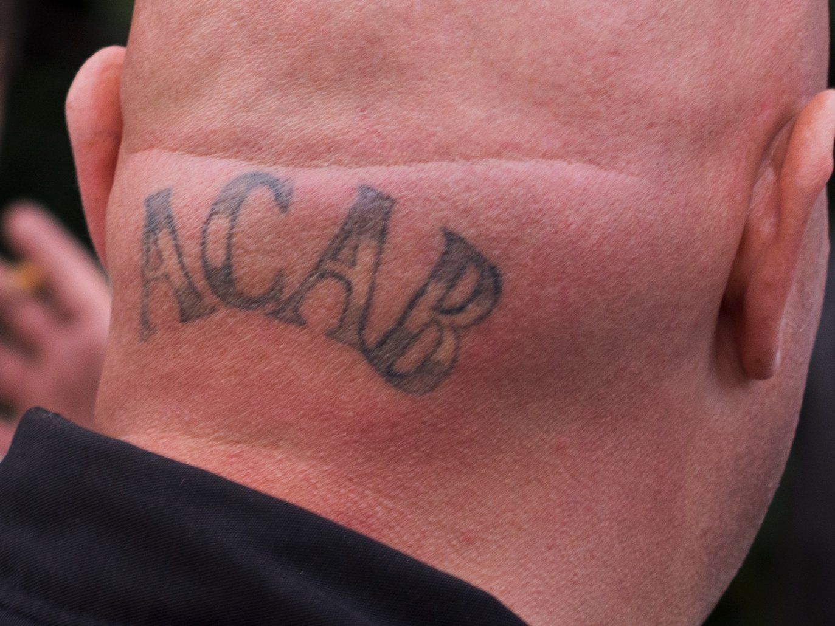
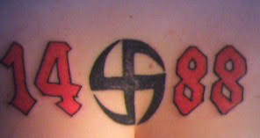
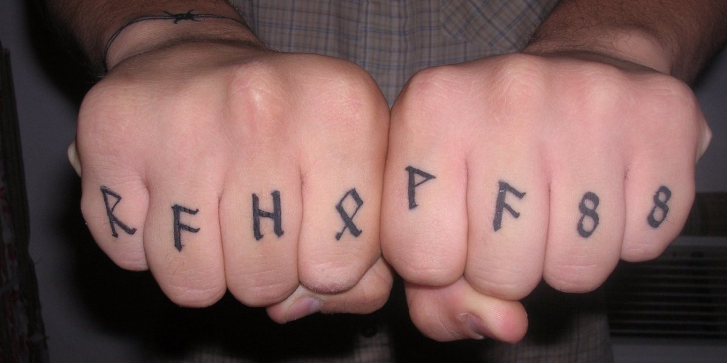
© 2019 Terry Oroszi
Acronym Hate Symbology
ACAB
All Cops Are Bastards
OFOF
One Front, One Family
AKAI
A Klansman I am
ORION
Our Race Is Our Nation
AYAK
Are You A Klansman
RAHOWA
Racial Holy War
FGRN
For God, Race, and Nation
ROA
Race Over All
GTKRWN
Gas the Kikes;
Race War Now
SS
Schutzstaffel, Nazi-era Symbol
HFFH
Hammerskins Forever, Forever Hammerskins
SWP
Supreme White Power
HSN
Hammerskin Nation
USAS
United Society of Aryan Skinheads
ITSUB
In The Sacred Unfailing Being
WAR
White Aryan Resistance
KABARK
Konstantly Applied By All Regular Klansmen
WP
White Power
KIGY
Klansman, I Greet You
WPWW
White Pride Worldwide
KLASP
Klannish Loyalty, A Sacred Principle
YWNRU
You Will Not Replace Us
LOTIE
Lady of The Invisible Empire (female Klan member)
ZOG
Zionist Occupied Government

Slide 7
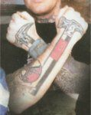
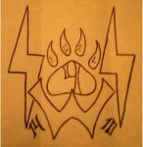
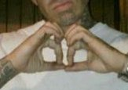
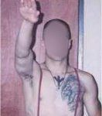
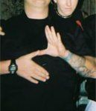
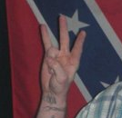
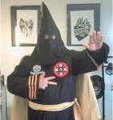
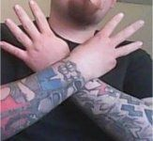
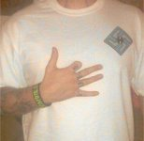
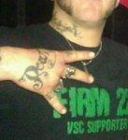
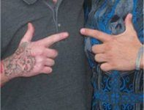
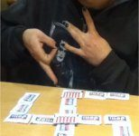
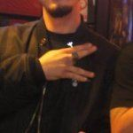
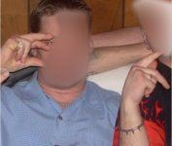
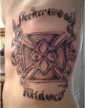
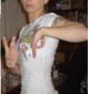
© 2019 Terry Oroszi
Hate Symbology: Hand Signs
23
Hand sign
“White Power”
(23rd letter)
Hammerskin
Hand sign
Two crossed forearms
Solid Wood Soldiers
Hand sign
Initials SWS, with the two S’s (lightning bolts) and a bear claw and
88
Hand sign
“Heil Hitler”
(8th letter)
Hitler Salute
Hand sign
"Heil Hitler" or "Sieg Heil."
SS
Hand sign
hands to make a lightning bolt symbol
Aryan Brotherhood of TX
Hand sign
A & B = 1 & 2
Ku Klux Klan
Hand sign
angling the index and middle finger to look like a “K”
Supreme White Alliance
Hand sign
Represent the number 43, SWA = 19+23+1
Aryan Circle Hand sign
A & C = 1 & 3
Okay
Hand sign
Used by many for the purpose of trolling liberals
Vinlanders Social Club
Hand sign
holding up the first, second, and fourth fingers of one hand
Aryan Nations Hand sign
“Bolts up” hand into a pistol shape and pointing it upwards
Peckerwood Hand sign
Originally a racial epithet against whites, now WP
Volksfront Hand sign
1-handed V or 2-handed VF
Peckerwood
Hand sign
diamond-shaped swastika inside a larger Iron Cross. Inside the swastika are SS bolts; outside the Iron Cross are the numbers 23/16
White Power
Hand sign
2-handed W & P.
European Kindred
Hand sign
E & K

Slide 8
© 2019 Terry Oroszi
Hate Symbology: Hand Signs
White supremacists, primarily on the West Coast, may use a two-handed hand sign consisting of one hand showing or flashing two fingers and the other hand showing or flashing three fingers.
The hand sign of the Hammerskins, a racist skinhead group, consists of two crossed forearms emulating the "crossed hammers" of the Hammerskins logo.
The Solid Wood Soldiers are a Texas-based white supremacist prison gang. The tattoo consists of the initials SWS, with the two S's represented by lightning bolts. Above the initials appears the image of a bear claw, with the number 4 in the middle and sometimes the letters HCRL.
The number 88 is a symbolically important number for white supremacists (who use it as a numeric code for "Heil Hitler"), so occasionally a white supremacist will use a hand sign to display or flash the number 88.
The Nazi salute debuted in Nazi Germany in the 1930s as a way to pay homage to Adolf Hitler. It consists of raising an outstretched right arm with the palm down.
In the 2000s, white supremacists created a handsign intended to memorialize the Schutzstaffeln or SS of Nazi Germany, Hitler's secret police, political army, and concentration camp guards.
The Aryan Brotherhood of Texas, a prison gang, uses a hand symbol consisting of a raised index finger and raised ring and little fingers, signifying the numbers 1 and 2.
Some Ku Klux Klan members use a hand sign that consists of angling the index and middle fingers out to the side in order to look vaguely like the letter "K."
The Supreme White Alliance was a hardcore racist skinhead gang based primarily in the Midwest.
A common hand gesture used by many on the for the purpose of trolling liberals, the symbol eventually came to be used by actual white supremacists as well. Caution must be used in evaluating instances of this symbol's use.
The hand sign used by the Vinlanders Social Club, a racist skinhead gang, consists of holding up the first, second, and fourth fingers of one hand.
The Aryan Circle is one of the largest white supremacist prison gangs in the US.
The largest white supremacist prison gang in Tennessee is Aryan Nations (a different group than the neo-Nazi group of the same name).
The term "peckerwood" originated as a racial epithet directed at whites. It has been adopted by the white supremacist prison gang subculture, especially in southern and western states, to refer to itself.
Members of the white supremacist group Volksfront used several handsigns to represent their gang. A common one-handed sign features the fingers of the right hand divided into a "V" shape, often held over the chest.
Some white supremacists, particularly in California, may use a two-handed handsign in which one hand forms the letter "W" and the other hand forms the letter "P," to represent WP or "White Power."
The European Kindred is a white supremacist prison gang based primarily in Oregon.
Peckerwood Midwest is a white supremacist gang based primarily in Missouri, active both in prisons and on the streets.

Slide 9
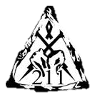
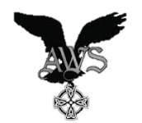
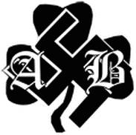
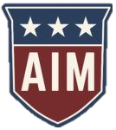
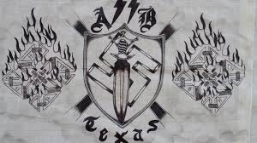
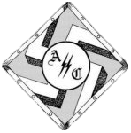
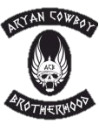
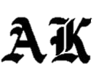
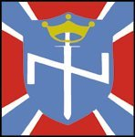
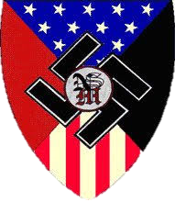
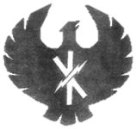
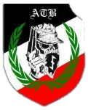
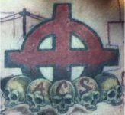
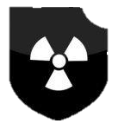
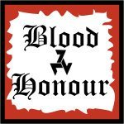
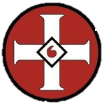
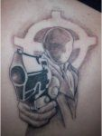
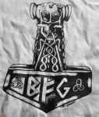
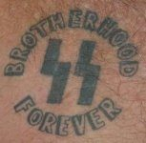
© 2019 Terry Oroszi
Hate Symbology: LOGOs
211 Crew
Soldiers of Aryan Culture
Advanced White Society
Alabama Aryan Brotherhood
The American Front
American Identity
Movement
The Aryan Brotherhood of Texas
The Aryan Cowboy Brotherhood
The Aryan Circle
The Aryan Knights
Aryan Nations
Tennessee
Aryan Renaissance Society
The Aryan
Terror Brigade
Aryan Nations
Aryan Warriors
Atomwaffen
Division
Blood & Honour
Mystic Insignia of a Klansman
Blue-eyed Devil
Bound for Glory
Brothers of
White Warriors
COORS Comrades of our Racial Struggle
Crazy White Boy/s
The Creativity Movement
Brotherhood Forever
Firm 22
Crew 1488
Daily Stormer
Book Clubs
The European Kindred
Free America Rally
Firm 22
Diversity = White Genocide

Slide 10
© 2019 Terry Oroszi
Hate Symbology: LOGOs
The 211 Crew is a large racist prison gang based in Colorado.
Soldiers of Aryan Culture (SAC) is a large Utah-based white supremacist prison gang.
The Advanced White Society is a small white supremacist group active in the Mid-Atlantic region and in Ohio.
The Alabama Aryan Brotherhood is an independent gang and has no connection to the "original" Aryan Brotherhood present in the California and federal prison systems.
The American Front is a longstanding racist skinhead group. In recent years, most of its members have been from California and Florida.
American Identity Movement is a large white supremacist group formerly known as Identity Evropa.
The Aryan Brotherhood of Texas is one of the largest and most violent white supremacist prison gangs in the United States.
The Aryan Circle is the second-largest white supremacist prison gang in Texas and one of the largest such gangs in the United States.
The Aryan Cowboy Brotherhood is a small white supremacist prison/street gang based primarily in Minn. and KY.
The Aryan Knights are a white supremacist prison gang based primarily in Idaho.
Aryan Nations is an old American neo-Nazi group with a long history of criminal activity.
The largest white supremacist prison gang in TN calls itself Aryan Nations, the two are separate groups.
The Aryan Renaissance Society is a white supremacist group with most members in Texas and New Jersey.
The Aryan Terror Brigade is a racist skinhead group with members in the United States and Europe.
The Aryan Warriors are a longstanding racist prison gang based in the Nevada prison system.
Atomwaffen Division is a neo-Nazi group that emerged in 2016. “Atomwaffen” is the German word for atomic weapons.
Blood & Honour, an international neo-Nazi/racist skinhead group started by British white supremacist and singer Ian Stuart.
The primary insignia of Ku Klux Klan groups is the MIOAK (or "Mystic Insignia of a Klansman"), commonly referred to as the "blood drop" cross.
Blue-eyed devil is a racial epithet directed at people of European ancestry that originated in Asia.
Bound for Glory is the name of a white power music band (dating back to 1989) from Minneapolis.
Brotherhood Forever is a racist prison gang based in Tennessee that is also known as the Tennessee Aryan Brotherhood.
Brothers of White Warriors is a New Hampshire-based white supremacist prison gang.
COORS, "Comrades of our Racial Struggle“ is a racist skinhead group primarily based in south CA. They use the COORS beer logo as well.
The term "Crazy White Boy/s" (or its initials) is a phrase used generically by some white supremacists.
The Creativity Movement is a white supremacist group that claims to be a religion for white people.
Crew 1488 (sometimes called Organization 1488) is a small racist prison gang based in Alaska and Colorado.
Daily Stormer Book Clubs are informal groups of supporters of white supremacist propagandist Andrew Anglin, who runs the Daily Stormer website.
The European Kindred is a large white supremacist prison gang based primarily in Oregon.
Firm 22 is the name used by the Vinlanders Social Club and refers to supporters of the group who are not actually members.
Free America Rally is a network of white supremacists who hold protests and rallies on white supremacist-related themes.

Slide 11
© 2019 Terry Oroszi
Hate Symbology: LOGOs
Georgia Aryan Brotherhood
Golden State Solidarity
Hammerskins (HSN)
The Hated
Identity Evropa
Indiana Aryan Brotherhood
Inland Empire Skinheads
Keystone State Skinheads
League of the South
Mississippi Aryan Brotherhood
National Alliance
National Rebirth of Poland
National Socialist Legion
National Socialist Movement
New Aryan Empire
New Black Panther Party for Self Defense
Northwest American Republic
National Socialist Movement
Ohio Aryan Brotherhood
Oklahoma Aryan Brotherhood
Patriot Front
Peckerwood Midwest
Public Enemy Number 1
Rise Above Movement
Sacred Separatist Group
Sadistic Souls
Saxon Knights
Shield Wall Network
Silent Aryan Warriors
Soldiers of Aryan Culture

Slide 12
© 2019 Terry Oroszi
Hate Symbology: LOGOs
The Georgia Aryan Brotherhood is a racist prison gang based in Georgia.
Golden State Solidarity (also known as Golden State Skinheads) is a California-based racist skinhead group.
The Hammerskins are a large racist skinhead gang with a history of violence.
The Hated is a racist skinhead group active in New Jersey, Florida, and elsewhere.
Identity Evropa was one of the most active white supremacist groups in the U.S. from 2016-19.
The Indiana Aryan Brotherhood is a large white supremacist prison gang based in Indiana.
The Inland Empire Skinheads (IES) are a racist skinhead group based in southern California.
The Keystone State Skinheads are a regional racist skinhead gang based in Pennsylvania.
The League of the South is a neo-Confederate white supremacist group.
The Mississippi Aryan Brotherhood is a large racist prison gang based in the Mississippi state prison system.
The National Alliance was the largest neo-Nazi group in the US in the 1990s but no more.
The National Rebirth of Poland is a Nazi-like extremist group based in Poland with followers in the US.
The National Socialist Legion is a small neo-Nazi group that originated in 2018.
The National Socialist Movement, though relatively small, is currently the largest neo-Nazi group in the US.
The New Aryan Empire is an Arkansas-based white supremacist prison gang.
The New Black Panther Party for Self Defense (not related to the original BPP) is the most extreme organized racist and anti-Semitic Af. Am, group in the US.
The "Northwest American Republic" is a fictional construct created by Harold Covington, a fringe figure in the neo-Nazi movement.
The National Socialist Movement (NSM) is a longstanding neo-Nazi group.
The Ohio Aryan Brotherhood is a longstanding white supremacist prison gang based in the Ohio prison system.
The Oklahoma Aryan Brotherhood is one of several white supremacist prison gangs in the Oklahoma prison system.
The Patriot Front is a white supremacist group in the United States.
Peckerwood Midwest is a white supremacist gang based in Missouri, active both in prisons and on the streets.
Public Enemy Number 1 is a large white supremacist gang based in the prisons and on the streets of California.
The Rise Above Movement is a CA alt right white supremacist group with a fitness and martial arts emphasis.
The Sacred Separatist Group (SSG) is a Missouri-based white supremacist prison gang.
Sadistic Souls is a small white supremacist outlaw biker gang active primarily in the Midwest.
The Saxon Knights are a large, Indiana-based white supremacist prison gang.
The Shield Wall Network (SWN) is a small, Arkansas-based white supremacist group.
The Silent Aryan Warriors (SAW) are a large white supremacist gang based in Utah.
Soldiers of Aryan Culture (SAC) is a large Utah-based white supremacist prison gang.

Slide 13
© 2019 Terry Oroszi
Hate Symbology: LOGOs
Solid Wood Soldiers
Southern Brotherhood
Stormfront
Supreme White Alliance
The Order
Traditionalist Youth Network
Unforgiven
Universal Aryan Brotherhood
United Society of Aryan Skinheads
Vanguard America
Vinlanders Social Club
Volksfront
White Aryan Resistance
Women for Aryan Unity
White Knights
The Solid Wood Soldiers are a Texas-based white supremacist prison gang.
The Southern Brotherhood is a large, Alabama-based white supremacist prison gang.
Stormfront is the oldest and largest white supremacist website on the Internet.
The Supreme White Alliance (SWA) was a hardcore racist skinhead gang based primarily in the Midwest.
The Order was an American white supremacist terrorist group from the early to mid-1980s.
The Traditionalist Youth Network was a small white supremacist group that on college campuses.
The Unforgiven are a large white supremacist prison gang based in the Florida prison system.
The Universal Aryan Brotherhood is a white supremacist prison gang based in the Oklahoma prison system.
The United Society of Aryan Skinheads (USA) is a white supremacist gang active in the prisons and on the streets.
Vanguard America is a small neo-Nazi group whose logo depicts an eagle carrying a fasces.
The Vinlanders Social Club (VSC) is one of the larger hardcore racist skinhead gangs in the US, (Indiana and Arizona).
Volksfront was a hybrid racist skinhead gang/neo-Nazi group that started in the 1990s -2010s.
White Aryan Resistance (WAR) is the name of a large, Arkansas-based white supremacist prison gang.
The White Knights are a Texas-based white supremacist prison gang (also active in AZ).
Women for Aryan Unity (WAU) is a longstanding white supremacist group for women.

